Slide 1
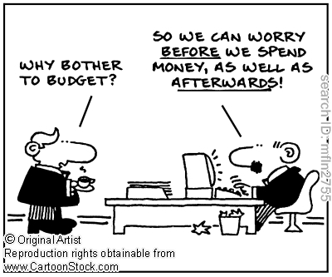
Introduction

Slide 2
Motivating examples
You plan to spend ₹20 lakh in capital expenditure (Property, plant, and equipment; PPE) in 2023. Do you invest if this will generate cashflows of
₹22 lakh in 2024; nothing before, and nothing thereafter.
₹10 lakh in 2024; ₹14 lakh in 2025; nothing before, and nothing thereafter.
₹25 lakh in 2025; nothing before; nothing before, and nothing thereafter.
How to decide?

Slide 3
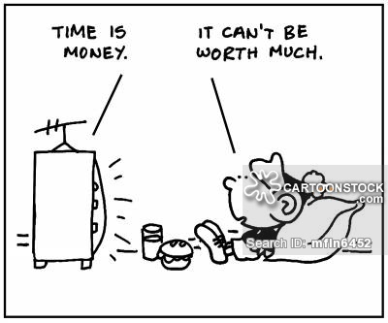
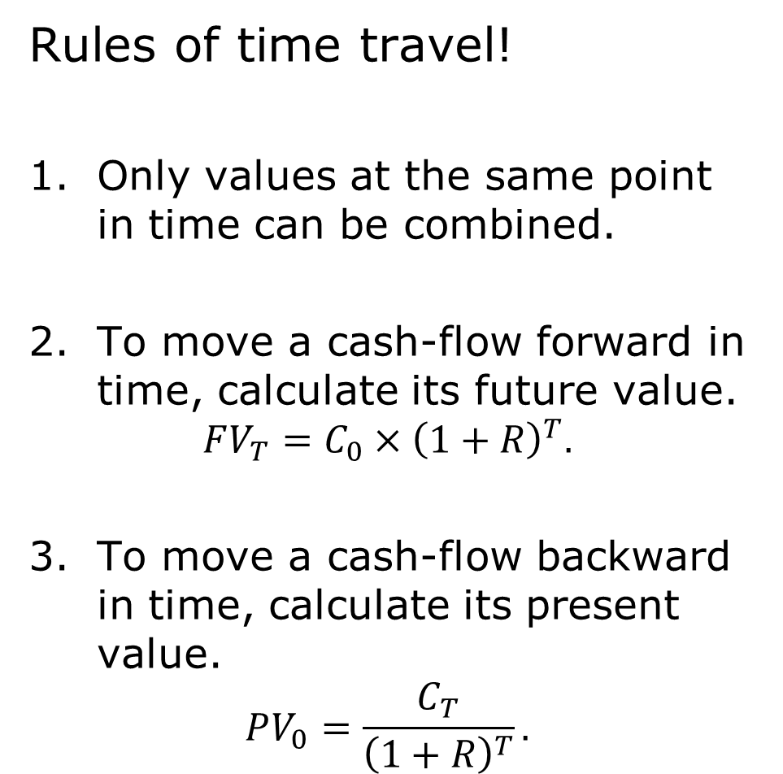
Quick detour into (time) value of money
Rules of time travel!
Only values at the same point in time can be combined.
To move a cash-flow forward in time, calculate its future value.
$$FV_{T}=C_{0}{×\left(1+R\right)}^{T}.$$
To move a cash-flow backward in time, calculate its present value.
$$PV_{0}=\frac{C_{T}}{{\left(1+R\right)}^{T}}.$$

Slide 4
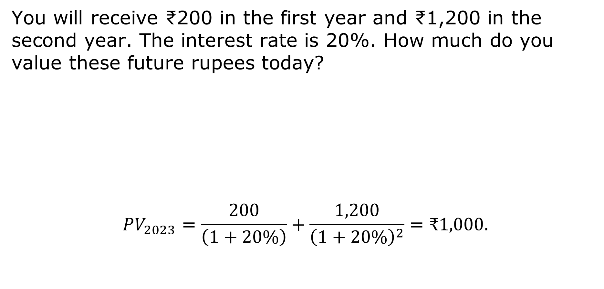
Present value (PV)
You will receive ₹200 in the first year and ₹1,200 in the second year. The interest rate is 20%. How much do you value these future rupees today?
$$PV_{2023}=\frac{200}{\left(1+20\%\right)}+\frac{1,200}{{\left(1+20\%\right)}^{2}}=\text{₹}1,000.$$
Today
2023
Year
2024
Year
2025
Date
Cash-flow
??
₹200
₹1,200

Slide 5
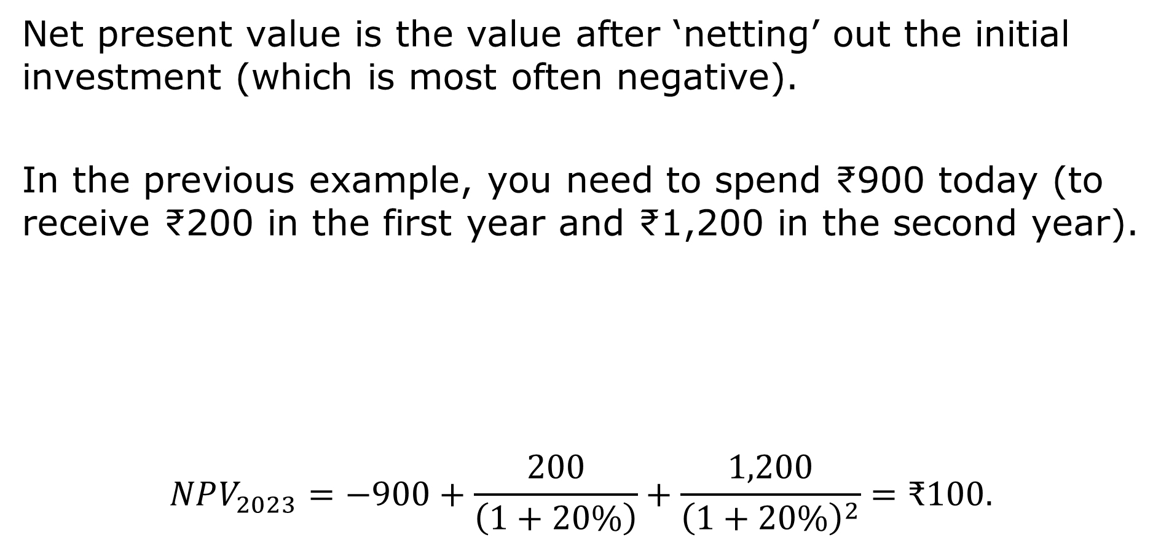
Net present value (NPV)
Net present value is the value after ‘netting’ out the initial investment (which is most often negative).
In the previous example, you need to spend ₹900 today (to receive ₹200 in the first year and ₹1,200 in the second year).
$$NPV_{2023}=−900+\frac{200}{\left(1+20\%\right)}+\frac{1,200}{{\left(1+20\%\right)}^{2}}=\text{₹}100.$$
Today
2023
Year
2024
Year
2025
Date
Cash-flow
−₹900
₹200
₹1,200

Slide 6
Capital budgeting rule
A capital budgeting rule is a method to decide which projects to take and which to reject.
Accept if NPV > 0 is the best rule.
Other rules (such as payback period and internal rate of return) can be helpful intuitively at times, and thus make some good sense (but have some limitations).

Slide 7
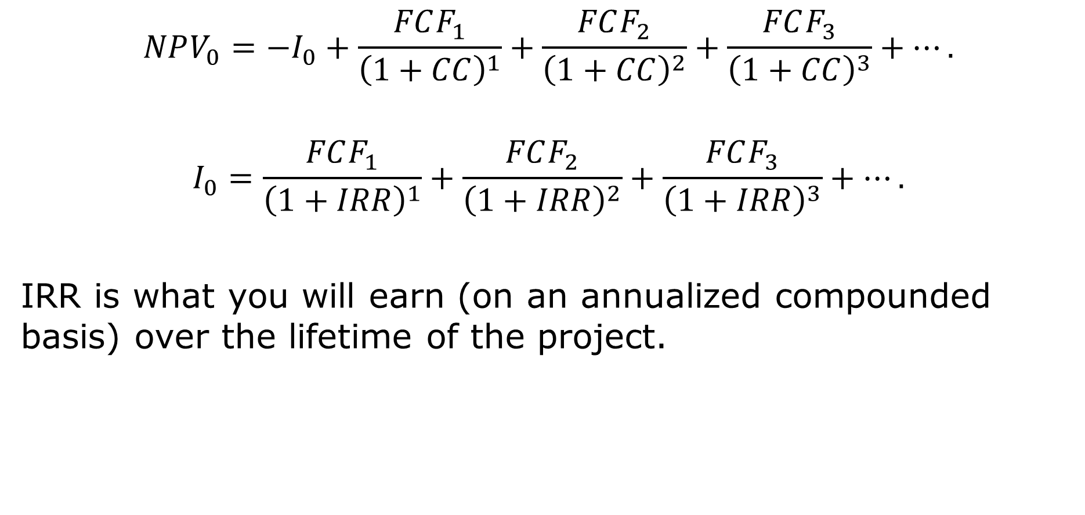
IRR
$$NPV_{0}=−I_{0}+\frac{FCF_{1}}{{\left(1+CC\right)}^{1}}+\frac{FCF_{2}}{{\left(1+CC\right)}^{2}}+\frac{FCF_{3}}{{\left(1+CC\right)}^{3}}+….$$
$$I_{0}=\frac{FCF_{1}}{{\left(1+IRR\right)}^{1}}+\frac{FCF_{2}}{{\left(1+IRR\right)}^{2}}+\frac{FCF_{3}}{{\left(1+IRR\right)}^{3}}+….$$
IRR is what you will earn (on an annualized compounded basis) over the lifetime of the project.

Slide 8
Relative IRR of the three projects
$$20=\frac{22}{{\left(1+IRR_{1}\right)}^{1}}⇒IRR_{1}=10.0\%.$$
$$20=\frac{10}{{\left(1+IRR_{2}\right)}^{1}}+\frac{14}{{\left(1+IRR_{2}\right)}^{2}}⇒IRR_{2}=12.3\%.$$
$$20=\frac{25}{{\left(1+IRR_{3}\right)}^{2}}⇒IRR_{3}=11.8\%.$$
All else equal, project 2 is the best.

Slide 9
IRR and investment
Still does not mean that we should undertake project 2.
That depends on what the cost of capital is.
One can state the investment rule as:
Invest if IRR>CC

Slide 10
Still …
In most cases, IRR>CC works. But still, it is the same as the NPV rules. In some cases, IRR rule is misleading.
Example: Which project do you undertake?
Investment of ₹20 lakh in 2023, ₹10 lakh in 2024; ₹14 lakh in 2025; nothing before, and nothing thereafter.
Investment of ₹20 in 2023, ₹10 in 2024; ₹14 in 2025; nothing before, and nothing thereafter.
Both projects have the same IRR of 12.3%. But the first project has higher NPV.

Slide 11
NPV used for
Buy or rent
New capital expenditures
Which technology to choose
Brand valuation
Cost reduction projects
Royalties
Company valuation
M&As and synergies
Etc.

Slide 12
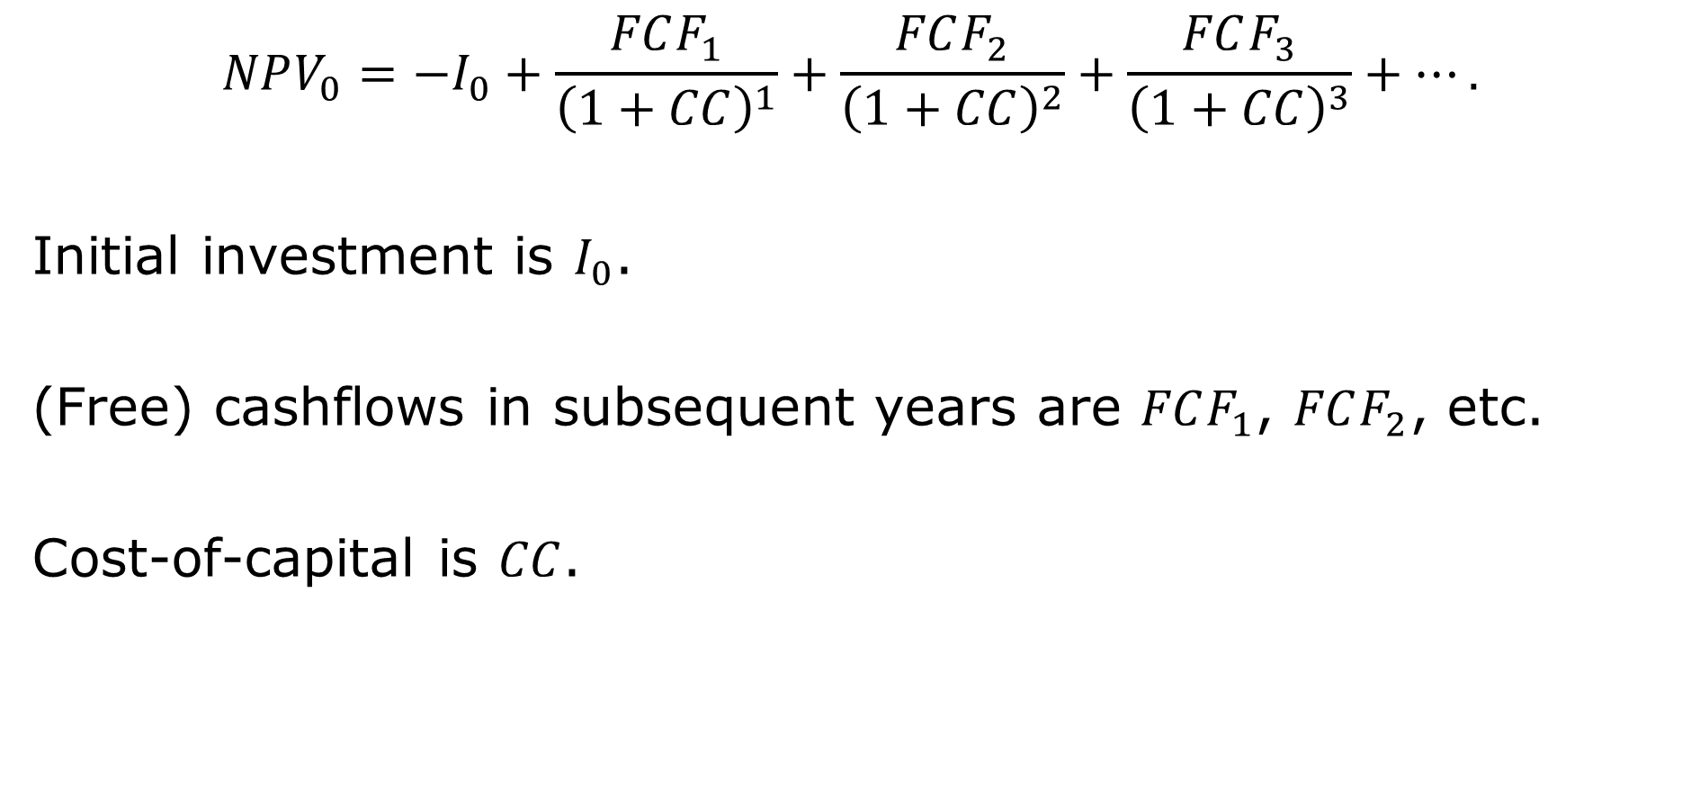
NPV again
$$NPV_{0}=−I_{0}+\frac{FCF_{1}}{{\left(1+CC\right)}^{1}}+\frac{FCF_{2}}{{\left(1+CC\right)}^{2}}+\frac{FCF_{3}}{{\left(1+CC\right)}^{3}}+….$$
Initial investment is $I_{0}$.
(Free) cashflows in subsequent years are $FCF_{1}$, $FCF_{2}$, etc.
Cost-of-capital is $CC$.

Slide 13
Free cash flow
Free cash flow to firm (FCFF) is the cash generated by the firm after taxes have been paid and the investing needs have been met.
It is the money available to return to shareholders and debtholders (bank loans and/or public debtholders).
Is roughly equal to the sum of “Cash flow from operating activities” and “Cash flow from investing activities” in the Statement of Cash Flows.

Slide 14
FCF calculation (1)
−
−
= a
−
=
−
=
+
−
−
=
Net Sales (Revenue)
Cost of goods sold (COGS)
Selling, general, and administrative (SG&A)
Earnings before interest, taxes, depreciation and amortization (EBITDA)
Depreciation & Amortization (D&A)
Earnings before interest and taxes (EBIT)
Taxes
Net operating profit/loss after taxes (NOPAT)
Depreciation & Amortization (D&A)
Capital Expenditure (Capex)
Change in Net working capital (ΔNWC)
Free cash flow (FCF)

Slide 15
FCF calculation (2)
FCF =
Operating activities
(Revenue − Costs − D&A)(1 − t) − (Capex − D&A + DNWC)
Investing activities

Slide 16
Why?
Use ‘EBITDA’ not ‘Net Income’ because depreciation is a non-cash expense.
Use changes in net working capital (NWC) because these changes imply net cash outlay not accounted for in net income (e.g., increase in inventory does not fall from the sky).
Capex is an actual cash outlay that is not accounted for in income statement (but is accounted for in cash flow statement).

Slide 17
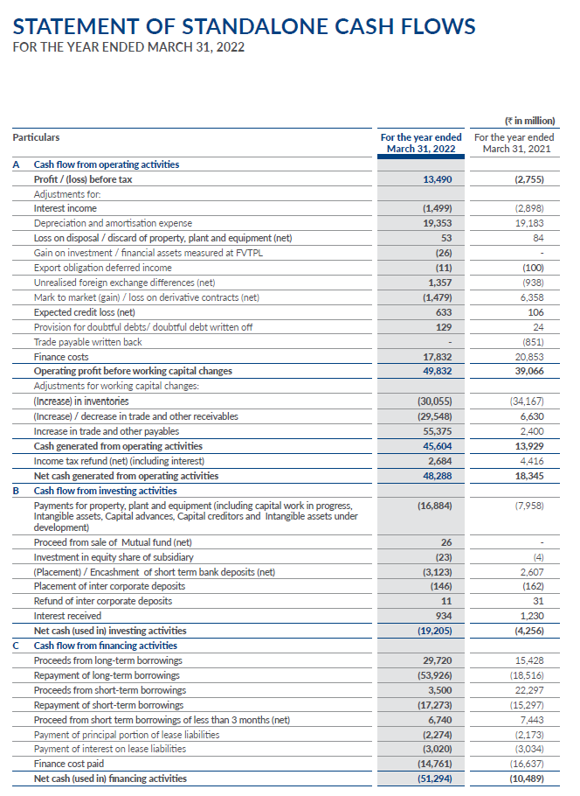
Nayara Energy
Earnings before taxes
Depreciation
EBITDA
Interest
ΔNWC
Capex

Slide 18
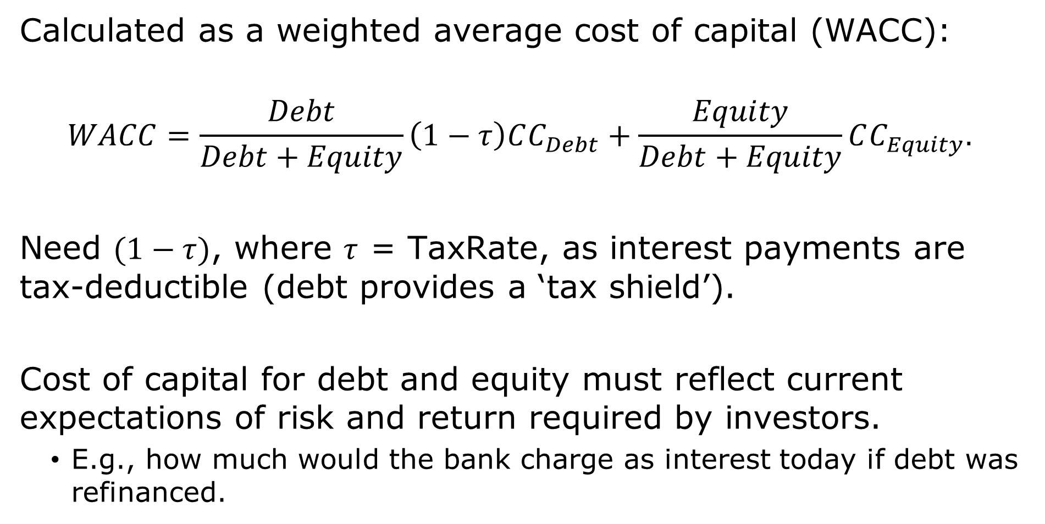
Cost of capital
Calculated as a weighted average cost of capital (WACC):
$$WACC=\frac{Debt}{Debt+Equity}\left(1−τ\right)CC_{Debt}+\frac{Equity}{Debt+Equity}CC_{Equity}.$$
Need $(1−τ)$, where $τ$ = TaxRate, as interest payments are tax-deductible (debt provides a ‘tax shield’).
Cost of capital for debt and equity must reflect current expectations of risk and return required by investors.
E.g., how much would the bank charge as interest today if debt was refinanced.

Slide 19
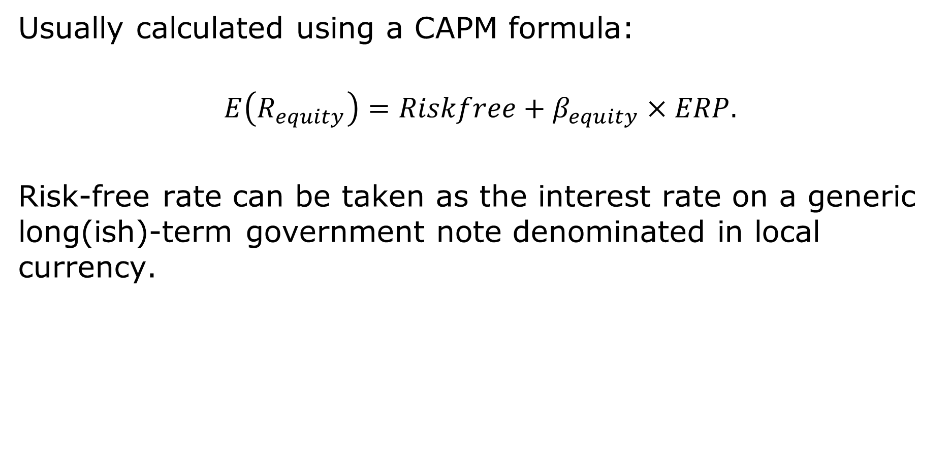
Cost of equity: CAPM
Usually calculated using a CAPM formula:
$$E\left(R_{equity}\right)=Riskfree+β_{equity}×ERP.$$
Risk-free rate can be taken as the interest rate on a generic long(ish)-term government note denominated in local currency.

Slide 20
Cost of equity: ERP
ERP is equity risk premium on the stock market.
Usually taken to be the same as the historical average:
Range of 4% to 6% for the U.S.
Range of 6% to 8% for India.

Slide 21
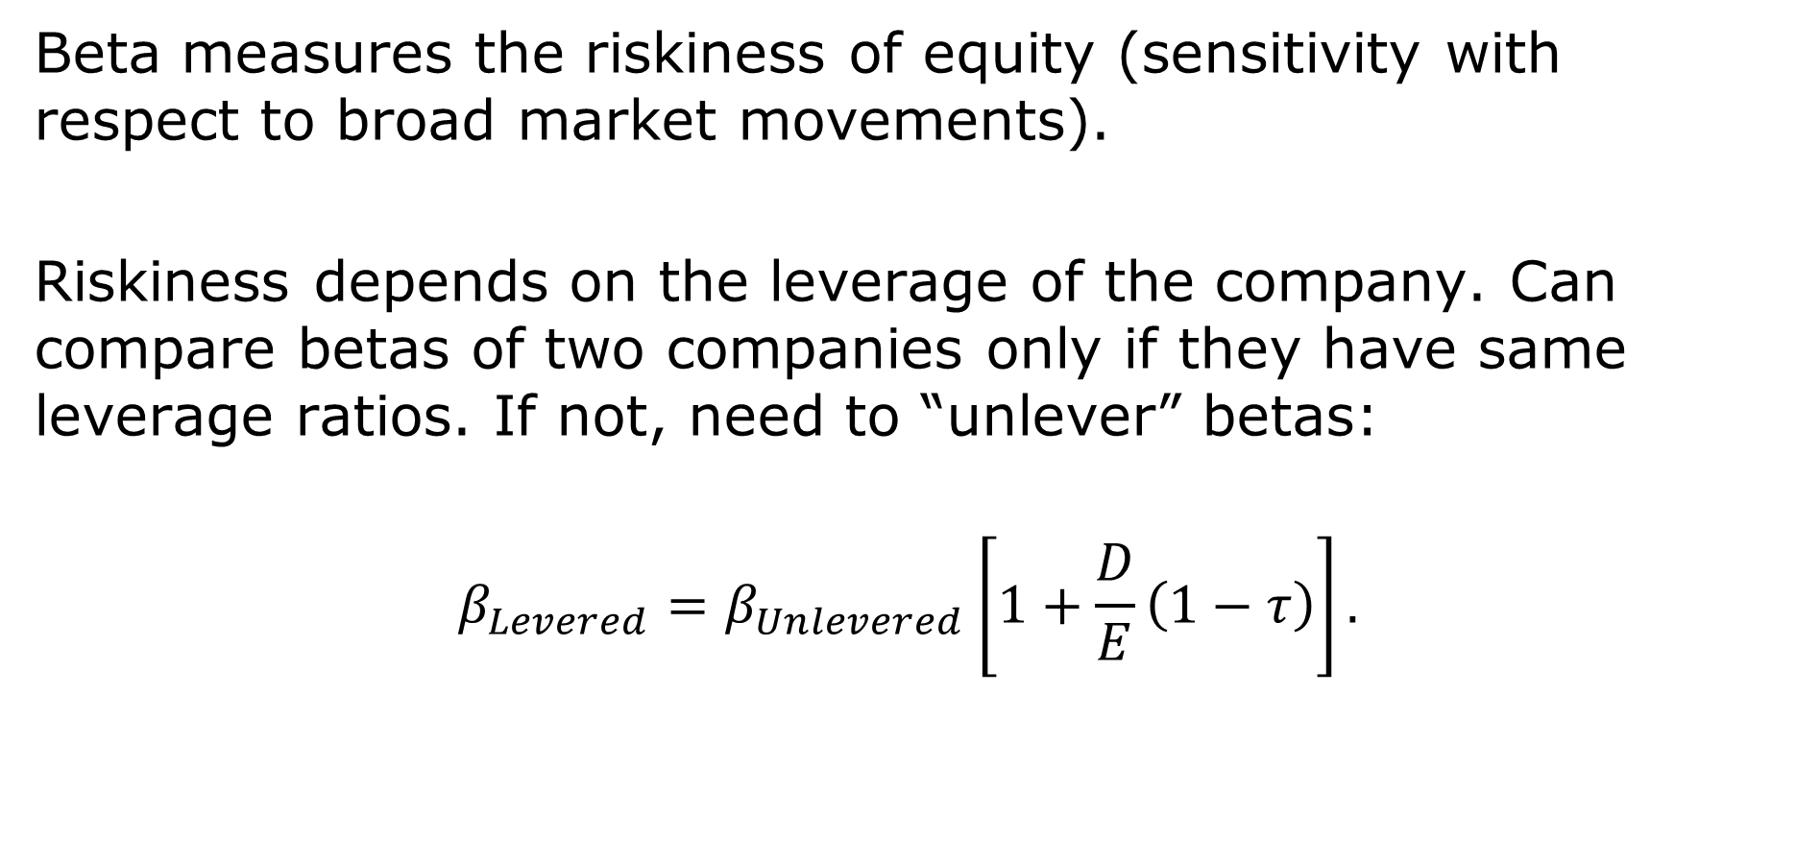
Cost of equity: $β$
Beta measures the riskiness of equity (sensitivity with respect to broad market movements).
Riskiness depends on the leverage of the company. Can compare betas of two companies only if they have same leverage ratios. If not, need to “unlever” betas:
$$β_{Levered}=β_{Unlevered}\left[1+\frac{D}{E}\left(1−τ\right)\right].$$

Slide 22
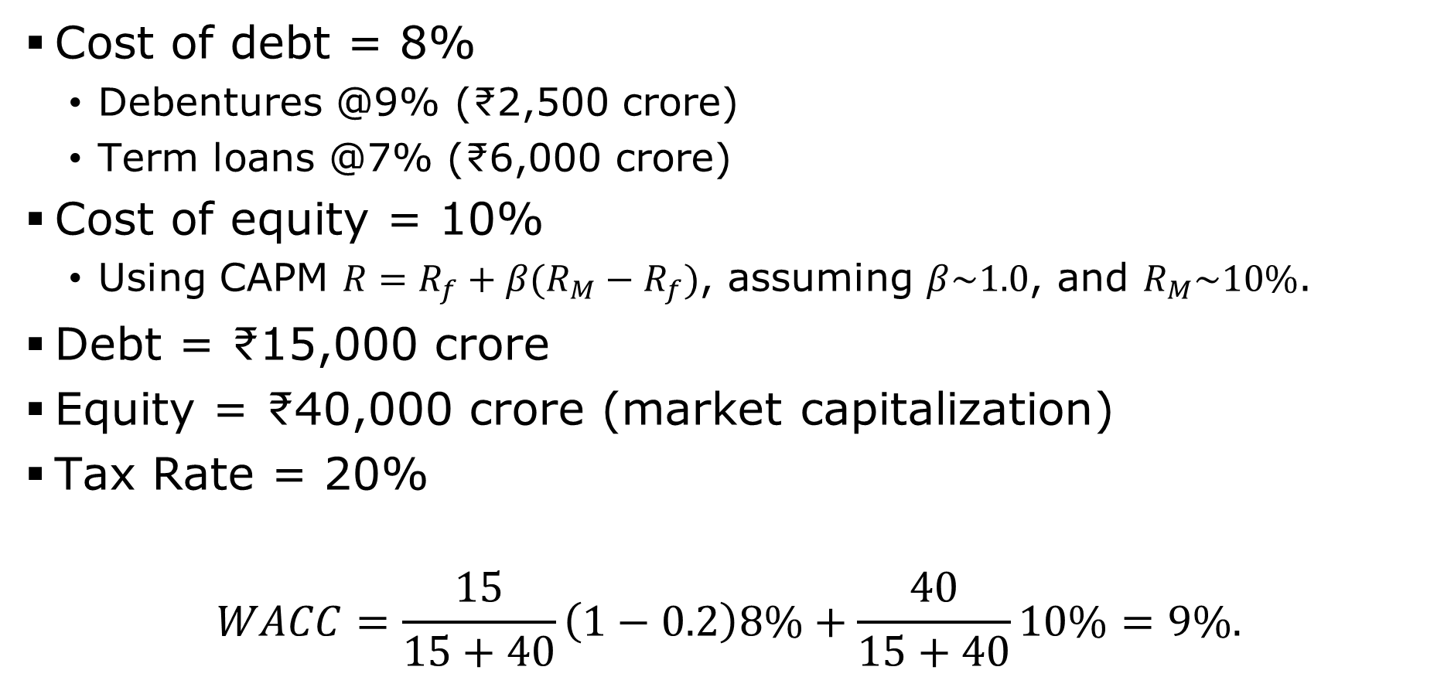
WACC for Nayara
Cost of debt = 8%
Debentures @9% (₹2,500 crore)
Term loans @7% (₹6,000 crore)
Cost of equity = 10%
Using CAPM $R=R_{f}+β(R_{M}−R_{f})$, assuming $β\sim 1.0$, and $R_{M}\sim 10\%$.
Debt = ₹15,000 crore
Equity = ₹40,000 crore (market capitalization)
Tax Rate = 20%
$$WACC=\frac{15}{15+40}\left(1−0.2\right)8\%+\frac{40}{15+40}10\%=9\%.$$

Slide 23
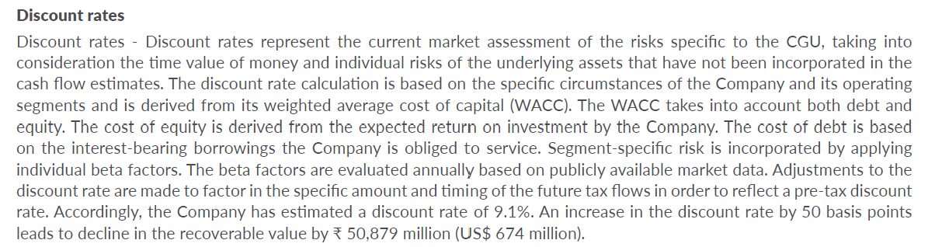
WACC …
Page 159 of the annual report:

Slide 24
Example
You plan to spend ₹2,000 crore on Jan 1st, 2023. This project will generate the following revenues and profits.
Is this a good project?
 |  |  |  | All figures in ₹ crore
 |  | 2023 | 2024 | 2025 | 2026 | 2027
Revenue |  | 6,000 | 6,300 | 6,615 | 6,880 | 7,155
Growth |  |  | 5% | 5% | 4% | 4%
EBITDA | 4% of sales | 240 | 252 | 265 | 275 | 286
NWC | 10% of sales | 24 | 25 | 26 | 28 | 29
Capex | 1% of sales | 60 | 63 | 66 | 69 | 72
 |  |  |  | Growth after 2027 is 2%

Slide 25
Example …
Sum of PVs = 120+116+111+106+102 = ₹555 crore.
This seems much less than the initial investment of ₹2,000 crore. Are we forgetting something?
 | 2023 | 2024 | 2025 | 2026 | 2027
FCFF | 131 | 137 | 144 | 150 | 156
FCFF/(1+WACC)^{t} | 120 | 116 | 111 | 106 | 102

Slide 26
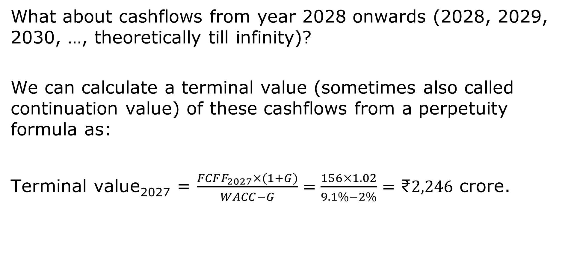
Example …
What about cashflows from year 2028 onwards (2028, 2029, 2030, …, theoretically till infinity)?
We can calculate a terminal value (sometimes also called continuation value) of these cashflows from a perpetuity formula as:
Terminal value₂₀₂₇ = $\frac{FCFF_{2027}×(1+G)}{WACC−G}=\frac{156×1.02}{9.1\%−2\%}=\text{₹}2,246$ crore.

Slide 27
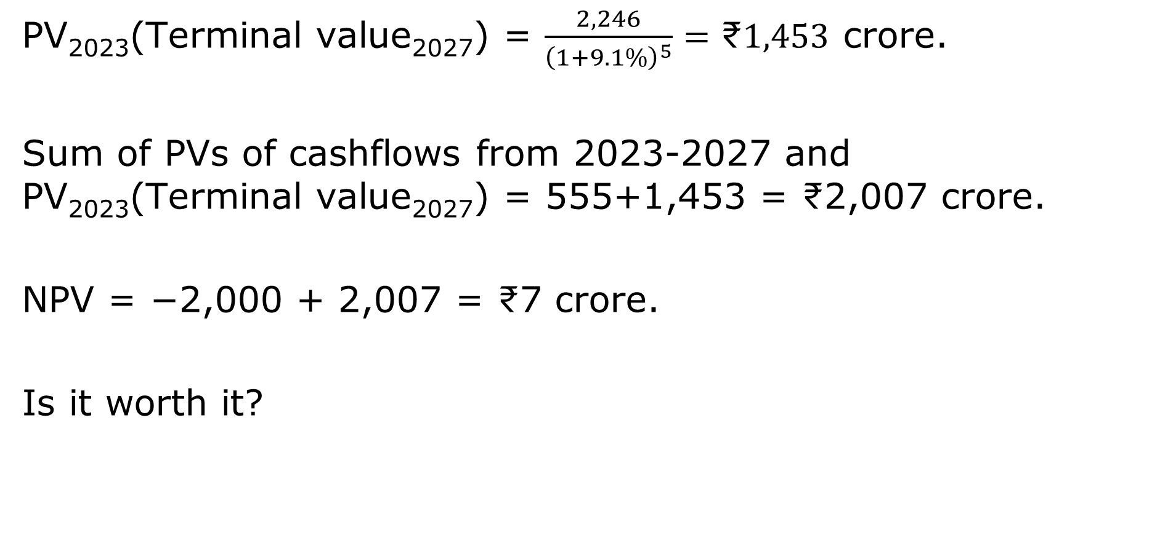
Example …
PV₂₀₂₃(Terminal value₂₀₂₇) = $\frac{2,246}{{\left(1+9.1\%\right)}^{5}}=\text{₹}1,453$ crore.
Sum of PVs of cashflows from 2023-2027 and PV₂₀₂₃(Terminal value₂₀₂₇) = 555+1,453 = ₹2,007 crore.
NPV = −2,000 + 2,007 = ₹7 crore.
Is it worth it?

Slide 28
Sensitivity analysis
If EBITA = 5% of sales, NPV = ₹738 crore.
If terminal growth rate = 3%, NPV = ₹261 crore.
If WACC = 10%, NPV = −₹222 crore.
With terminal growth rate = 3%, NPV = −₹31 crore.
With EBITDA = 5% of sales, NPV = ₹426 crore.

Slide 29
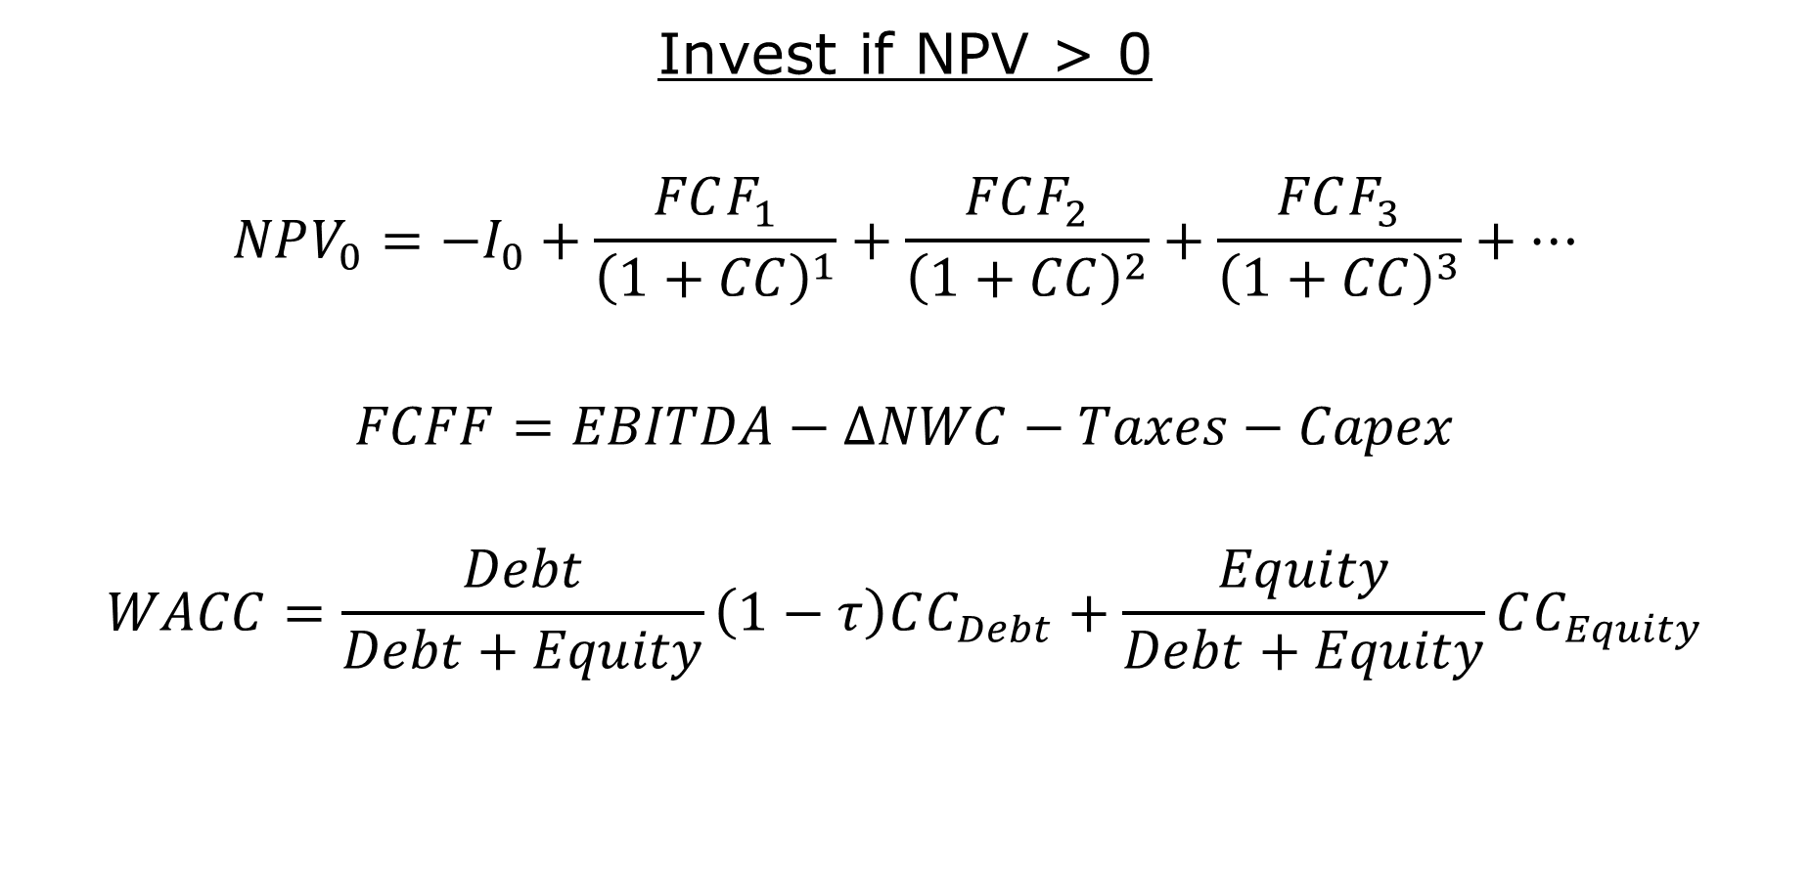
Takeaways
Invest if NPV > 0
$$NPV_{0}=−I_{0}+\frac{FCF_{1}}{{\left(1+CC\right)}^{1}}+\frac{FCF_{2}}{{\left(1+CC\right)}^{2}}+\frac{FCF_{3}}{{\left(1+CC\right)}^{3}}+…$$
$$FCFF=EBITDA−ΔNWC−Taxes−Capex$$
$$WACC=\frac{Debt}{Debt+Equity}\left(1−τ\right)CC_{Debt}+\frac{Equity}{Debt+Equity}CC_{Equity}$$

